Slide 1
MATHEMATICS FOR COMPUTING
WEEK 1 - LECTURE
MODULE INTRODUCTION AND ALGEBRAIC METHODS

Slide 2
Module Introduction
Logistics
Tutors: Subair Ali (ML), Ikrom Mirzarustamovich
Office: New 310
Email: sliayakath@wiut.uz
Series of tutorials: 12 Weeks
Module Code: 4COSC012C

Slide 3
Assessment
Test 1 – 25%
Test 2 – 25%
Exam – 50%

Slide 4
Learning Outcomes
By the end of the module the successful student will be able to:
Use fundamental mathematical notation to accurately carry out basic algebraic manipulations
Apply linear algebra to solve systems of linear equations in terms of vectors and matrices
Apply concepts of sets, relations and functions to solve simple problems
Apply combinatorics and statistics to evaluate probability of events
Apply the fundamental principles of calculus for problem solving
Use the basic concepts of Boolean algebra and Logic to solve simple problems.

Slide 5
Algebraic Methods Introduction
The word 'algebra' comes from the title of a book Al-jabr w'al muqabala written in 830 AD by the Arabic astronomer Al - Khurarizuri. The extract translation of the title is disputed: 'al - jabr' means something like "restoring and balancing" (which refers to the idea of shifting things from one side of an equation to the other).
And 'w'al muqabala' means something like "cancelling and simplifying". These two ideas reflect the central art of algebra - namely that of' rearranging and simplifying expressions'.

Slide 6
Algebraic Methods Introduction
A variable is an important concept of algebra. It can be an object or a letter that represents a number of things. We use variables to represent unknowns, to represent quantities that vary, and to generalize properties.
An equation is a mathematical sentence with an equal sign.
Example: 3 + 5 = 8
Inequality is a mathematical sentence that contains symbols <, >, ≤, ≥, or ≠.
Example: 4x + 7y ≥ 15

Slide 7
Example
Tina wants to buy pencils and pens for $15. Each pencil costs $1, and the pen costs $2 each. If x represents the number of pencils and y stands for pens, then
x + 2y ≤ 15

Slide 8


Patterns
A pattern is a regular arrangement of numbers, objects or shapes. There are mainly two types of patterns:
Increasing or decreasing pattern:
12, 24, 36, 48,...
108, 102, 96, 90,...
Repeating pattern:

Slide 9
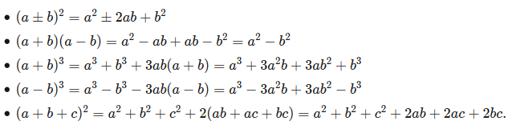
Algebraic Manipulation
Algebraic manipulation refers to the manipulation of algebraic expressions, often into a simpler form or a form which is more easily handled and dealt with. It is useful to memorize the following algebraic expansions of various formula, as you will encounter them almost everywhere as you continue on your journey of problem solving:

Slide 10



Examples
What is the missing number?
The answer is 6, right? Because 6 − 2 = 4. Easy stuff.
Well, in Algebra we don't use blank boxes, we use a letter (usually an x or y, but any letter is fine). So we write:
It is really that simple. The letter (in this case an x) just means "we don't know this yet", and is often called the unknown or the variable.
And when we solve it we write:

Slide 11
Why Use a Letter?
It is easier to write "x" than drawing empty boxes (and easier to say "x" than "the empty box").
If there are several empty boxes (several "unknowns") we can use a different letter for each one.

Slide 12
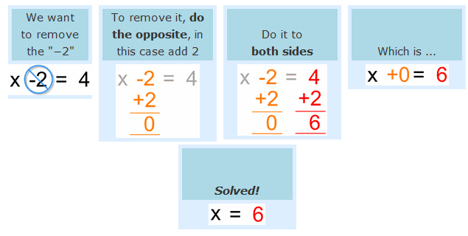
How to Solve
Here is an example:

Slide 13
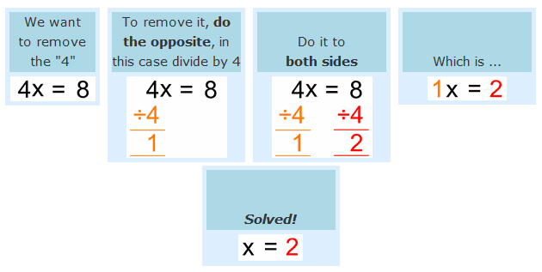
How to Solve Multiplication
What is the opposite of multiplying? Dividing!
Have a look at this example:

Slide 14
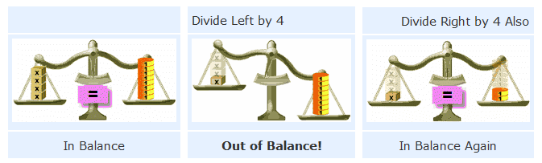
Why did we divide by 4 on both sides?
Because of the need for balance ...
Just remember ...
To keep the balance, what we do to one side of the "=" we should also do to the other side!

Slide 15
References
https://en.wikipedia.org/wiki/Algebra
https://www.bbc.co.uk/bitesize/topics/z9yb4wx/articles/zkf7xfr
https://www.youtube.com/watch?v=vDqOoI-4Z6M&list=PL7AF1C14AF1B05894

Slide 16
Done for Today
Thank You

